Slide 1
Aggregate Planning
(Sales & Operations Planning)
Dr. Narpat Ram Sangwa
Assistant Professor
Operations & Supply Chain Management
IIM Sirmaur

Slide 2
Learning Objectives
What does aggregate planning do?
How to respond the demand fluctuation?
How do organization define an aggregate plan?
What are the basic trade-offs strategies to consider when creating an aggregate plan.

Slide 3
The Planning Process
Long-range plans (over two year)
Capacity decisions are critical to long range plans
Issues:
Research and Development
New product plans
Capital investments
Facility location/expansion
Top executives
Intermediate-range plans (3 to 18 months)
Issues:
Sales and operations planning
Production planning and budgeting
Setting employment, inventory,
subcontracting levels
Analyzing operating plans
Operations managers with sales and operations planning team
Short-range plans (up to 3 months)
Scheduling techniques
Issues:
Job assignments
Ordering
Job scheduling
Dispatching
Overtime
Part-time help
Operations managers, supervisors, foremen
Responsibility
Planning tasks and time horizons

Slide 4
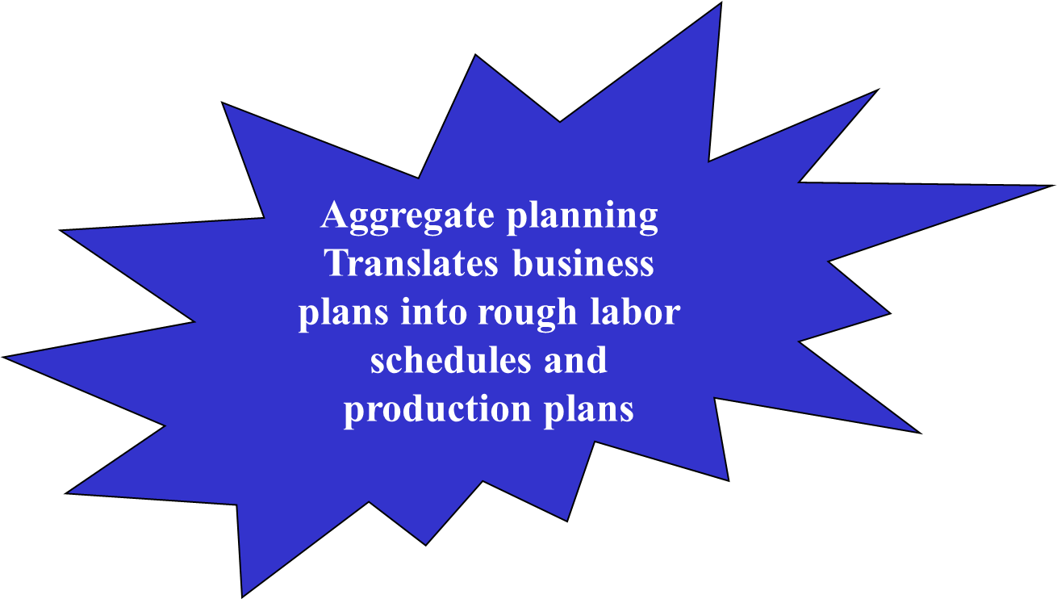
Aggregate Planning
Sales and Operations Planning (S&OP) is an aggregate planning process that determines the resource capacity a firm will need to meet its demand over an intermediate time horizon—6 to 18 months in the future.
The term ‘aggregate’ is used because the plans are developed for product lines or product families, rather than individual products.

Slide 5
The Concept of Aggregation
Why do organizations need to do aggregate planning?
Planning.
It takes time to implement plans.
Capacity has a cost and lead times are often long.
Strategic.
Aggregation is important because it is not possible to predict with any degree of accuracy the timing and volume of demand for individual items.
It is connected to the budgeting process.
It can help synchronize flow throughout the supply chain; it affects costs, equipment utilization, employment levels, and customer satisfaction.
How can a firm best use the facilities it has?

Slide 6
Aggregation
The plan must be in units of measurement that can be understood by the firm’s non-operations personnel:
Aggregate units of output per month.
Dollar value of total monthly output.
Total output by factory.
Measures that relate to capacity such as labor hours.

Slide 7
Aggregation
Red Tomato Tools Example
Table: Costs, Revenues, and Times at Red Tomato Tools
Family | Material Cost/ Unit ($) | Revenue/ Unit ($) | Setup Time/Batch (hour) | Average Batch Size | Production Time/ Unit (hour) | Net Production Time/Unit (hour) | Percentage Share of Units Sold
A | 15 | 54 | 8 | 50 | 5.60 | 5.76 | 10
B | 7 | 30 | 6 | 150 | 3.00 | 3.04 | 25
C | 9 | 39 | 8 | 100 | 3.80 | 3.88 | 20
D | 12 | 49 | 10 | 50 | 4.80 | 5.00 | 10
E | 9 | 36 | 6 | 100 | 3.60 | 3.66 | 20
F | 13 | 48 | 5 | 75 | 4.30 | 4.37 | 15

Slide 8
Aggregation
Red Tomato Tools Example
  Material cost per aggregate unit
    = (15 × 0.10) + (7 × 0.25) + (9 × 0.20) + (12 × 0.10) + (9 × 0.20) + (13 × 0.15) = $10
Similarly
Revenue per aggregate unit = $40
Net production time per aggregate unit = 4.00 hours

Slide 9
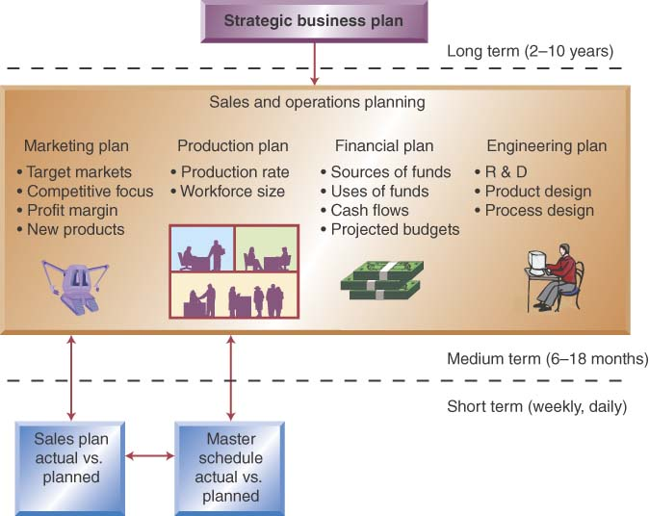
The Role of the Aggregate Plan

Slide 10
Objectives of Aggregate Planning
To establish a company-wide operation plan for allocating resources
To develop an economic strategy for meeting demand.
To minimize cost over the planning period by adjusting
  Production rates
  Labor levels
  Inventory levels
  Overtime work
  Subcontracting rates
  Other controllable variables

Slide 11
Characteristics of Aggregate Planning
It specify the planning horizon (typically 3-18 months)
It specify the duration of each period
It specify key information required to develop an aggregate plan

Slide 12
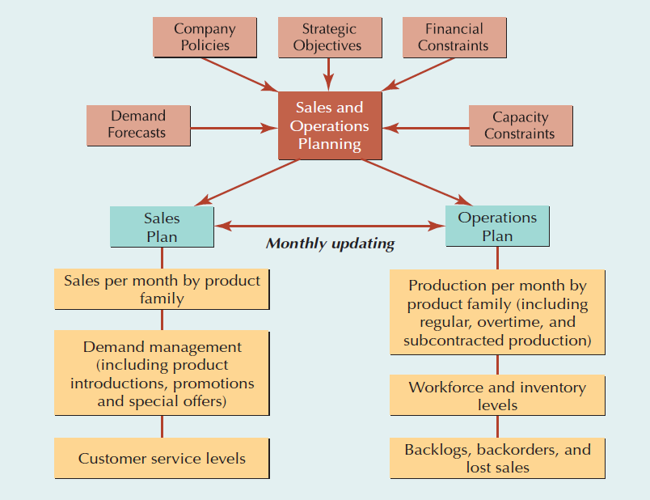
Sales and Operations Planning

Slide 13
Aggregate Planning Inputs
Resources/ capacity constraints
  Workforce
  Facilities
Demand forecast
Policy statements
  Subcontracting
  Overtime
  Inventory levels
  Back orders
Costs/financial constraints
  Inventory carrying ($/unit/period)
  Backlog orders ($/unit/period)
  Hiring/firing ($/labor)
  Overtime ($/hr)
  Subcontracting ($/hr or $/unit)
  Stockout ($/unit/period)

Slide 14
Aggregate Planning Outputs
Production quantity from regular time, overtime, and subcontracted time
Inventory held
Backlog/stockout quantity
Workforce hired/laid off
Machine capacity increase/decrease
A poor aggregate plan can result in lost sales, lost profits, excess inventory, or excess capacity

Slide 15
Quick Review
True or False
Correct Answer: True
The goal of aggregate planning is to achieve a production plan that attempts to balance the organization's resources and meet expected demand.

Slide 16
Quick Review
True or False
Correct Answer: True
Ultimately the overriding factor in choosing a strategy in aggregate planning is overall cost.

Slide 17
Quick Review
MCQ
Correct Answer: D
Which of the following is an input to aggregate planning?
Beginning inventory
Forecasts for each period of the schedule
Customer orders
All of the above

Slide 18
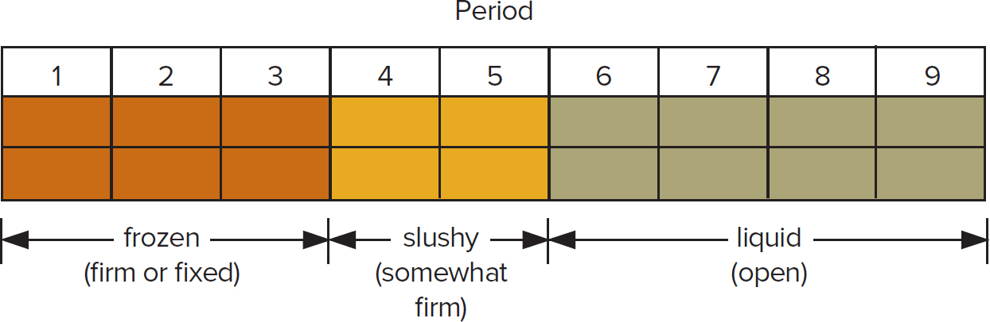
Dealing with Variation in Aggregate Plans
Most organizations use rolling 3-, 6-, 9-, and 12- month forecasts:
Forecasts are updated periodically - rather than relying on a once-a-year forecast.
Capacity strategies (reactive)
  Change in capacity to satisfy higher demand than forecasted
  Build and carry extra inventories to satisfy higher than forecasted demand
Demand strategies (proactive)
Change in demand by offering incentives in other periods

Slide 19
Strategies for Adjusting Capacity
Aggregate planning becomes more of a challenge when demand fluctuates over the planning horizon.
For example, seasonal demand patterns can be met by:
1. Hiring and firing workers to match demand (chase demand)
2. Producing at a constant rate and using inventory to absorb fluctuations in demand (level production)
3. Maintaining resources for high-demand levels (Peak demand)
4. Increasing or decreasing working hours (overtime and undertime)
5. Subcontracting work to other firms
6. Using part-time workers
7. Providing the service or product at a later time period (backordering)
When one of these alternatives is selected, a company is said to have a pure strategy for meeting demand.
When two or more are selected, a company has a mixed strategy.

Slide 20
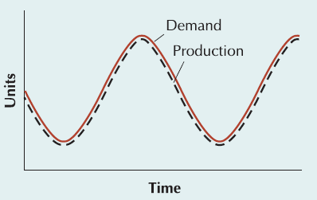
Chase Strategy
Vary machine capacity or hire and lay off workers as demand varies
Often difficult to vary capacity and workforce on short notice
Expensive if cost of varying capacity is high
Negative effect on workforce morale
Results in low levels of inventory
Used when inventory holding costs are high and costs of changing capacity are low

Slide 21
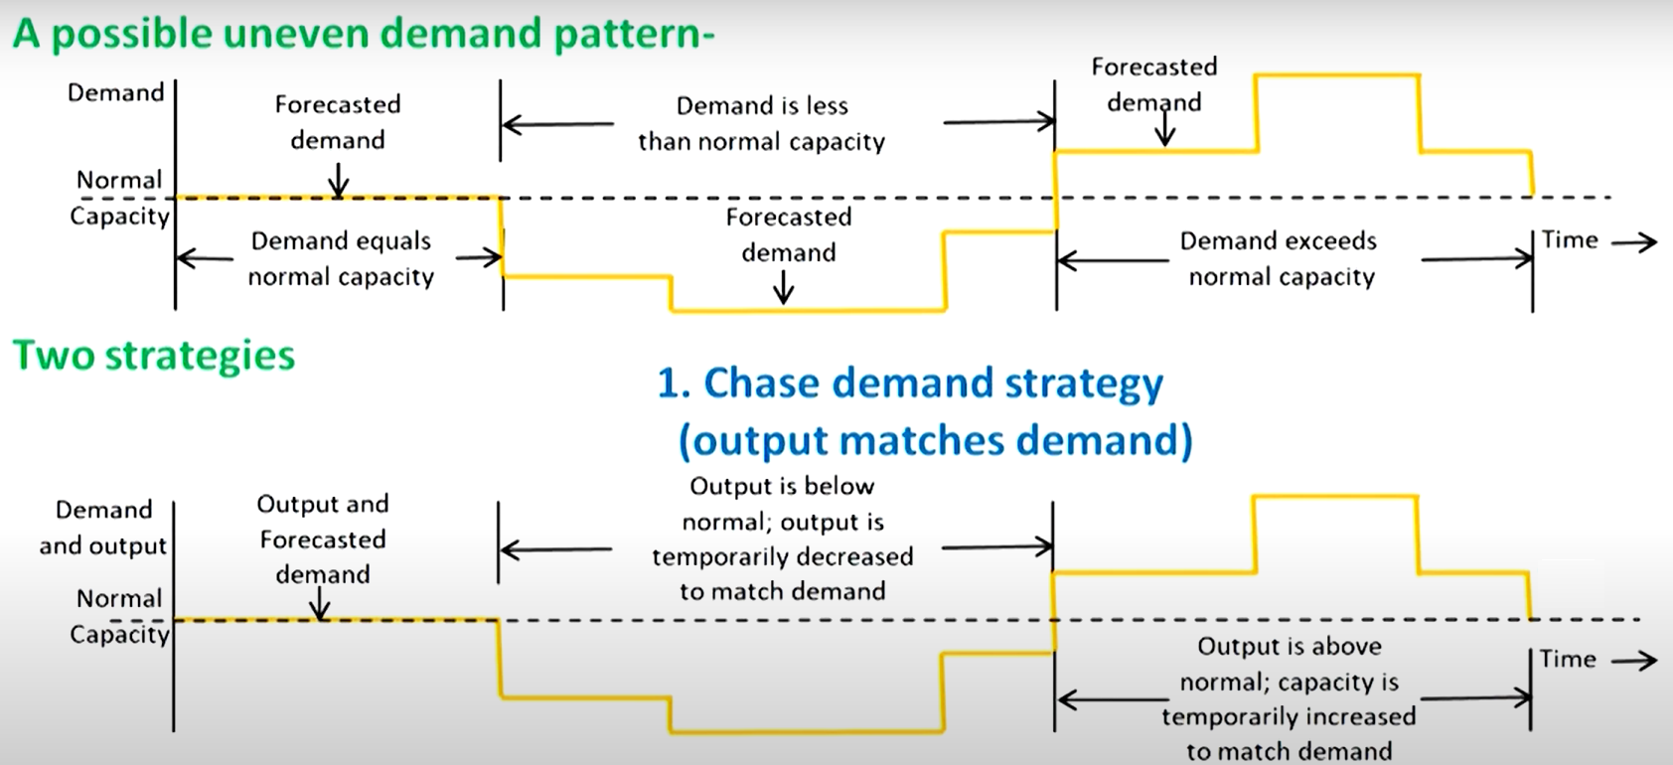
Chase Strategy Example

Slide 22
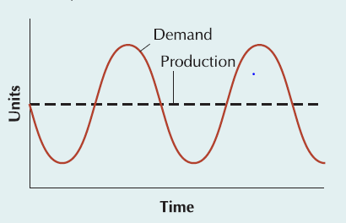
Level Strategy
Stable machine capacity and workforce levels, constant output rate
Inventory levels fluctuate over time
Inventories carried over from high to low demand periods
Better for worker morale
Large inventories and backlogs may accumulate
Used when inventory holding and backlog costs are relatively low

Slide 23
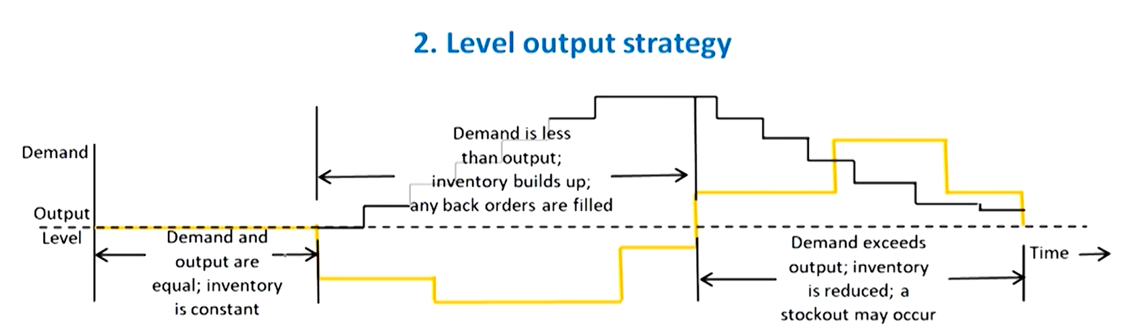
Level Strategy Example

Slide 24
Peak Demand Strategy
Use excess machine capacity
Maintaining resources for peak demand levels ensures high levels of customer service but can be very costly in terms of the investment in extra workers and machines that remain idle during low-demand periods.
This strategy is used when superior customer service is important or when customers are willing to pay extra for the availability of critical staff or equipment.

Slide 25
Overtime and Undertime
Overtime and undertime are common strategies when demand fluctuations are not extreme.
Overtime
A competent staff is maintained, hiring and firing costs are avoided, and demand is met temporarily without investing in permanent resources.
Undertime
It can be achieved by working fewer hours during the day or fewer days per week.
In addition, vacation time can be scheduled during months of slow demand.

Slide 26
Subcontracting and Part-time Workers
Subcontracting
Subcontracting or outsourcing is a feasible alternative if a supplier can reliably meet quality and time requirements.
This is a common solution for component parts when demand exceeds expectations for the final product.
Part-time workers
Using part-time workers is feasible for unskilled jobs or in areas with large temporary labor pools (such as students, homemakers, or retirees).
Part-time workers are less costly than full-time workers—they receive no health-care or retirement benefits—and are more flexible—their hours usually vary considerably.

Slide 27
Backlogs and Out-of-stock
Backlog: accumulated customer orders to be completed at a later date.
It grows during periods of high demand and is depleted during periods of low demand.
The planned backlog is an important part of the aggregate plan.
Out-of-stock: Temporary unavailability of an item.
Lost sales due to out-of-stock items.
Backordering can be used to decrease lost in sales.

Slide 28
Strategies for Managing Demand
Strategies for managing demand include—
Create new demand
Backordering
Shifting demand into other time periods with incentives or by varying pricing, sales promotions, and advertising campaigns.
Examples: Winter coat specials in July and bathing-suit sales in January are attempts to shift demand into different time periods.
Offering products or services with countercyclical demand patterns.
This approach involves examining the idleness of resources and creating a demand for those resources.
McDonald’s offers breakfast to keep its kitchens busy during the prelunch hours.
Heating firms also sell air conditioners.

Slide 29
Quick Review
True or False
Correct Answer: True
A “chase” strategy in aggregate planning would attempt to match capacity and demand.

Slide 30
Quick Review
MCQ
Correct Answer: D
Which one of the following is not a basic option for altering demand?
Promotion
Backordering
Pricing
Subcontracting

Slide 31
Quantitative Techniques for Aggregate Planning
The different quantitative techniques are—
Pure strategies
Mixed strategies
Linear programming: Methods for obtaining optimal solutions to problems involving the allocation of scarce resources in terms of cost minimization or profit maximization.
Problem can be formulated as a transportation-type programming model.
Simulation models: Computerized models that can be tested under a variety of conditions in an attempt to identify reasonably acceptable solutions to problems.
Some other quantitative techniques

Slide 32
Pure Strategies
Solving aggregate planning problems involves—
Formulating strategies for meeting demand,
Constructing production plans from those strategies,
Determining the cost and feasibility of each plan, and
Selecting the lowest cost plan from among the feasible alternatives.
The effectiveness of the aggregate planning process is directly related to management’s understanding of the cost variables involved and the reasonableness of the scenarios tested.

Slide 33
Aggregate Planning using Pure Strategies Example 1
The Good and Rich Candy Company makes a variety of candies in three factories worldwide. Its line of chocolate candies exhibits a highly seasonal demand pattern, with peaks during the winter months (for the holiday season and Valentine’s Day) and valleys during the summer months (when chocolate tends to melt and customers are watching their weight). Given the following costs and quarterly sales forecasts, determine whether (a) level production, or (b) chase demand would more economically meet the demand for chocolate candies:
QUARTER SALES FORECAST (LB)
Spring 80,000
Summer 50,000
Fall 120,000
Winter 150,000

Slide 34
Aggregate Planning using Pure Strategies Example 2
Given
Hiring cost = $100 per worker
Firing cost = $500 per worker
Inventory carrying cost = $0.50 pound per quarter
Production per employee = 1,000 pounds per quarter
Beginning work force = 100 workers
Solution
Level production
(50,000 + 120,000 + 150,000 + 80,000)
4
= 100,000 pounds

Slide 35
Aggregate Planning using Pure Strategies Example 1
Level Production
Strategy
SALES PRODUCTION
QUARTER FORECAST PLAN INVENTORY
Spring 80,000 100,000 20,000
Summer 50,000 100,000 70,000
Fall 120,000 100,000 50,000
Winter 150,000 100,000 0
400,000 140,000
Cost = 140,000 pounds x 0.50 per pound = $70,000

Slide 36
Aggregate Planning using Pure Strategies Example 1
Chase Demand
Strategy
SALES PRODUCTION WORKERS WORKERS WORKERS
QUARTER FORECAST PLAN NEEDED HIRED FIRED
Spring 80,000 80,000 80 0 20
Summer 50,000 50,000 50 0 30
Fall 120,000 120,000 120 70 0
Winter 150,000 150,000 150 30 0
100 50
Cost = (100 workers hired x $100) + (50 workers fired x $500)
= $10,000 + 25,000 = $35,000
Comparing the cost of level production with chase demand, we find that chase demand is the best strategy for the Good and Rich line of candies.

Slide 37
Mixed strategies
Varying two or more capacity factors to determine a feasible production plan.
Mixed strategies can incorporate management policies, such as “no more than x% of the workforce can be laid off in one quarter” or “inventory levels cannot exceed x dollars.”

Slide 38
Linear programming Example 1
Minimize Z = $100 (H₁ + H₂ + H₃ + H₄) + $500 (F₁ + F₂ + F₃ + F₄) + $0.50 (I₁ + I₂ + I₃ + I₄)
Subject to
P₁ - I₁ = 80,000 (1)
Demand I₁ + P₂ - I₂ = 50,000 (2)
constraints I₂ + P₃ - I₃ = 120,000 (3)
I₃ + P₄ - I₄ = 150,000 (4)
Production 1000 W₁ = P₁ (5)
constraints 1000 W₂ = P₂ (6)
1000 W₃ = P₃ (7)
1000 W₄ = P₄ (8)
100 + H₁ - F₁ = W₁ (9)
Work force W₁ + H₂ - F₂ = W₂ (10)
constraints W₂ + H₃ - F₃ = W₃ (11)
W₃ + H₄ - F₄ = W₄ (12)
where
H_{t} = # hired for period t
F_{t} = # fired for period t
I_{t} = inventory at end of period t
P_{t} = units produced in period t
W_{t} = workforce size for period t

Slide 39
Red Tomato Tools Example (1 of 5)
Highly seasonal demand
Options
  Adding workers during peak times
  Subcontract
  Build up inventory
Develop a forecast
Month | Demand Forecast
January | 1,600
February | 3,000
March | 3,200
April | 3,800
May | 2,200
June | 2,200

Slide 40
Red Tomato Tools Example (2 of 5)
Starting inventory in January = 1,000
20 working days each month
Employees earn $4/hour regular time
Regular time = 8 hours/day, then overtime
Maximum 10 hours overtime/employee/month
End June with 500 units in inventory
Item | Cost
Material cost | $10/unit
Inventory holding cost | $2/unit/month
Marginal cost of stockout/backlog | $5/unit/month
Hiring and training costs | $300/worker
Layoff cost | $500/worker
Labor hours required | 4/unit
Regular time cost | $4/hour
Overtime cost | $6/hour
Cost of subcontracting | $30/unit

Slide 41
Red Tomato Tools Example (3 of 5)
Decision Variables
For t = 1, ..., 6
W_{t} = Workforce size for month t
H_{t} = Number of employees hired at the beginning of month t
L_{t} = Number of employees laid off at the beginning of month t
P_{t} = Production in month t
I_{t} = Inventory at the end of month t
S_{t} = Number of units stocked out at the end of month t
C_{t} = Number of units subcontracted for month t
O_{t} = Number of overtime hours worked in month t

Slide 42
Red Tomato Tools Example (4 of 5)
Objective Function
Minimize
  (Regular-time labor cost) + (Overtime labor cost) + (Cost of hiring and layoffs) + (Cost of holding inventory) + (Cost of stocking out) + (Material cost) + (Cost of subcontracting)

Slide 43
Red Tomato Tools Example (5 of 5)
Constraints
All for t = 1,..., 6
Workforce, hiring, and layoff constraints
Capacity constraints
Inventory balance constraints
Overtime limit constraints

Slide 44
Transportation Method
For cases in which the decision to change the size of the workforce has already been made or is prohibited, the transportation method of linear programming can be used to develop an aggregate production plan.
The transportation method gathers all the cost information into one matrix and plans production based on the lowest-cost alternatives.

Slide 45
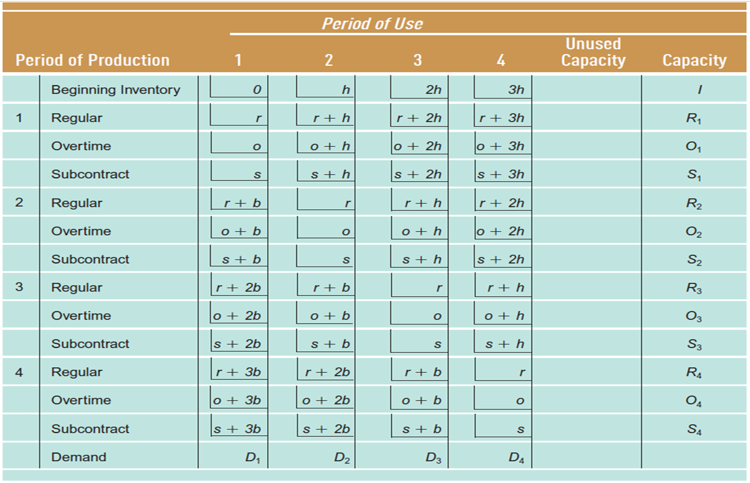
Transportation Method

Slide 46
Transportation Method
Example 3
A Manufacturing Company uses overtime, inventory, and subcontracting to absorb fluctuations in demand. An aggregate production plan is devised annually and updated quarterly. Cost data, expected demand, and available capacities in units for the next four quarters are given here. Demand must be satisfied in the period it occurs; that is, no backordering is allowed. Design a production plan that will satisfy demand at minimum cost.
Quarter | Expected demand | Regular capacity | Overtime capacity | Subcontract capacity
1 | 900 | 1000 | 100 | 500
2 | 1500 | 1200 | 150 | 500
3 | 1600 | 1300 | 200 | 500
4 | 3000 | 1300 | 200 | 500
Regular production cost per unit =$20;
Overtime production cost per unit =$25
Subcontracting cost per unit =$28;
Inventory holding cost per unit per period= $ 3
Beginning inventory = 300 units

Slide 47
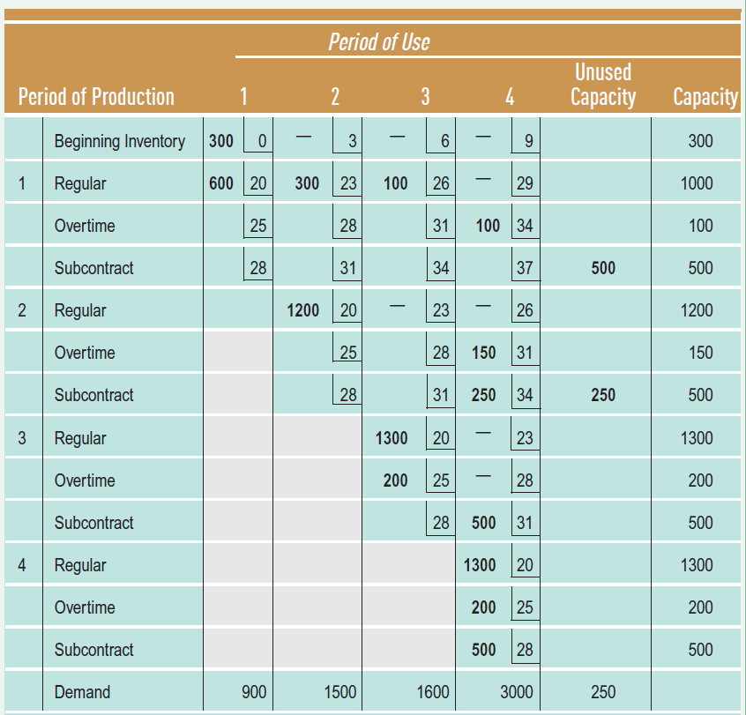
Transportation Method

Slide 48
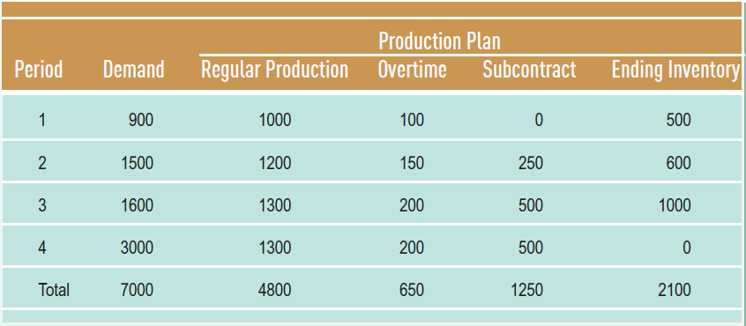
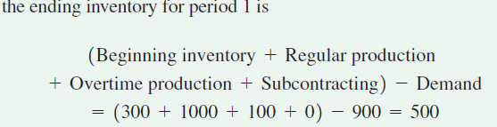
Transportation Method

Slide 49


Thank You

